Slide 1
ANALYSIS OF STATE OF cs education policies, success metrics, and ecep cape framework
Lawrence Tanimoto

Slide 2
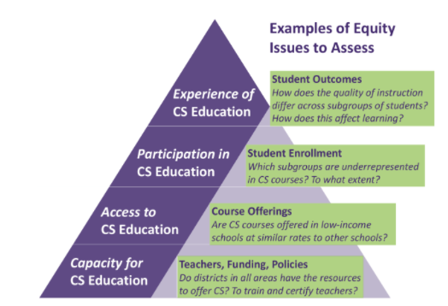
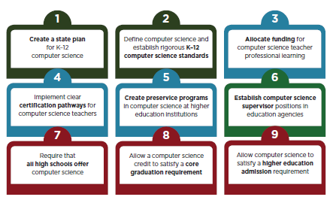
Success Metrics in Report
ECEP CAPE Framework
AP CS Info
% of Students Enrolled in Foundational CS
% of Students in HS with CS
% HS with Foundational CS
Code.org
Pro-CSEd Policies
Number of Pro-CSEd Policies Implemented

Slide 3
objectives
Better understand of the success metrics in 2021 State of CS Ed Report
Understand how success at lower layers in CAPE affect higher layers
Understand which policies are most effective at improving success metrics
Suggest improvements to what policies to promote, success metrics to track
2021 State of CS Education report focuses on what policies have been implemented by which states and the % of high schools have a foundational CS course success metric. This report analyze data collected for the report but not necessarily highlighted and tries to add value and understanding

Slide 4
SUCCESS METRIC Summary
 | # of Policies | % of HS with FCS | % Students in HS w/ CS | % Students Enrolled in FCS
State Avg | 5.16 | 57.4% | 77.6% | 4.9%
State Std Dev | 2.42 | 17.7% | 11.9% | 3.3%
National Avg | 5.48 | 51.3% | 77.7% | 4.7%
States w/Data | 51 | 51 | 51 | 36
State Avg is average where each state has equal weight
National Avg is average weighted by number of schools or number of students

Slide 5
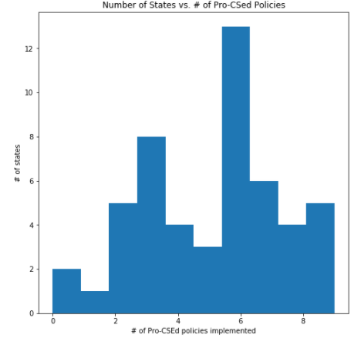
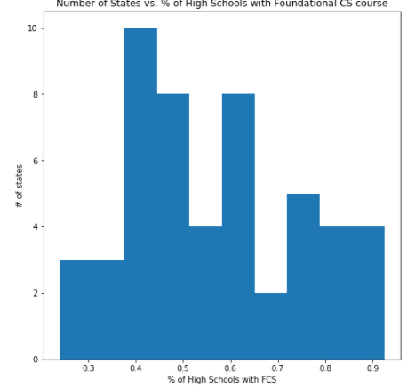
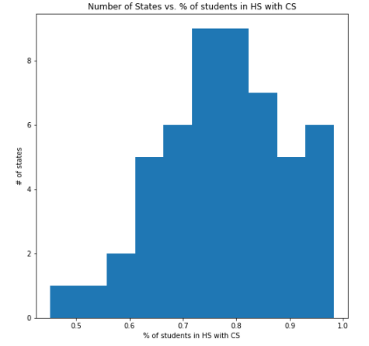
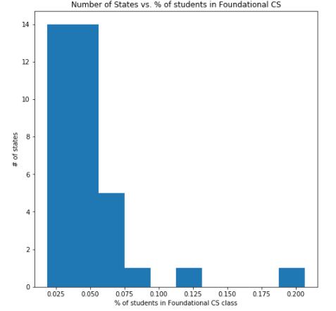
SUCCESS Metric HISTOGRAMs
# of Policies
% of HS with FCS
% Students in HS w/ CS
% Students Enrolled in FCS

Slide 6
Observations
CSEd Report focuses on # of policies implemented, % of HS with Foundational CS metrics
Reported 51.7% of HS with Foundational CS is national average weighed down by large states; 57.4% is average over all states equal weighted.
% of Students in HS with CS may include High Schools with a “Computer Science” class that do not have the 20 hours of coding to be considered “foundational”
% of Students in HS with CS is roughly 40% - 50% higher than % of HS with Foundational CS; % of HS with Foundational CS is roughly 10 times larger than % Students in Foundational CS

Slide 7
OUTLIERS (More THAN 2 StdEV)
# Policies (5.16 State Avg)
Oregon – 0
% High Schools with Foundational CS (57.4% State Avg)
No Outliers
% Students in HS with CS (77.6% State Avg)
District of Columbia (50.8%)
Louisiana (45.1%)
% Students in Foundational CS (4.9% State Avg)
South Carolina (20.7%)
Maryland (12.5%)

Slide 8
SUCCESS METRICS RELATIONSHIPS
X Value | Y Value | Line of Regression | R2 Value
# of Policies | % of HS with FCS | 0.047 x + 0.333 | .404
# of Policies | % Students in HS with CS | 0.028 x + 0.631 | .328
% of HS with FCS | % Students in HS with CS | 0.567 x + 0.451 | .716
# of Policies | % Students in FCS | 0.005 x + 0.021 | .127
% of HS with FCS | % Students in FCS | 0.115 x - 0.019 | .363
% Students in HS with CS | % Students in FCS | 0.158 x - 0.077 | .295

Slide 9
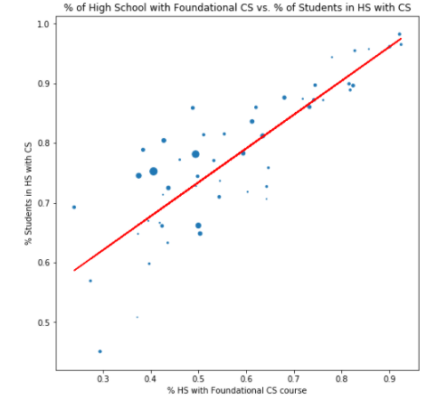
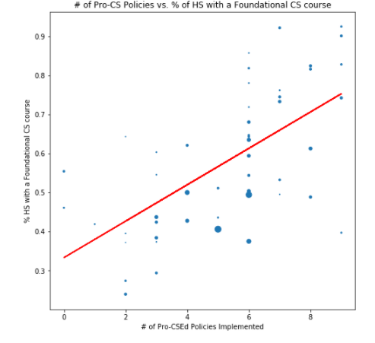
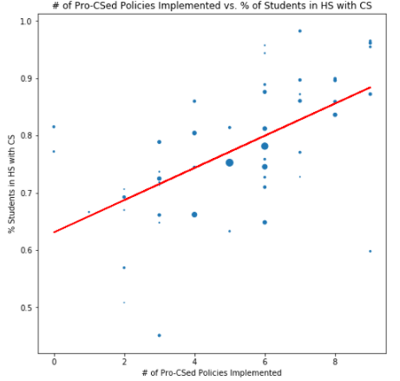
% HS with Foundational CS
Vs
% Students in HS with CS
# of Policies
vs.
% of HS with Foundational CS
R2 = .716
# of Policies
Vs
% Students in HS with CS
R2 = .404
Size of dots reflect # HS, # Students; not reflected in regression
R2 = .328

Slide 10
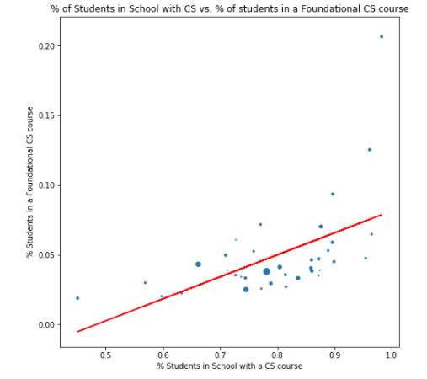
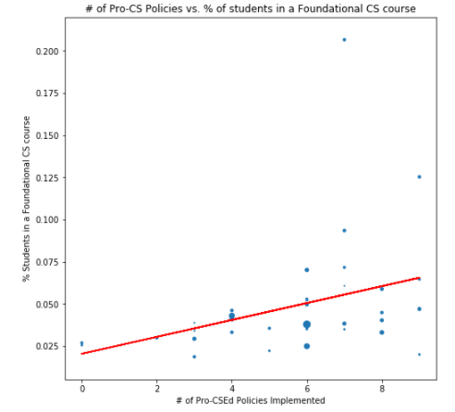
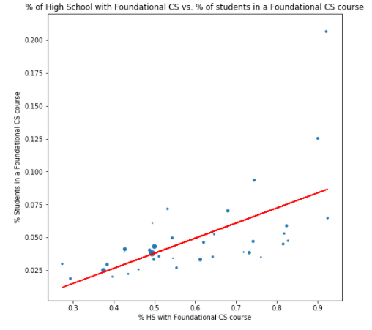
% Students in HS with CS
Vs.
% of Students in Foundational CS
# of Policies
vs.
% of Students in Foundational CS
R2 = .295
% HS with Foundational CS
Vs
% of Students in Foundational CS
R2 = .127
Size of dots reflect # HS, # Students; not reflected in regression
R2 = .363

Slide 11
observations
Relative R-squared values used to understand how success metrics correlate to each other
CsEd report indicates R-squared of appx 0.42 for line of regression between # of policies and % of HS with foundational CS; The R-squared shows here indicates .404. Difference likely due to how policies considered implemented
Strongest relationship between % of HS with foundational CS and % of students in HS with CS (.716). If all schools were same size and all CS were FCS, R-squared would be 1.0.
Predictive power of # of policies decreases as go up the CAPE pyramid (.408 -> .328 -> .127)
Despite lower position in CAPE pyramid, % of HS with foundational CS (.363) is a better predictor than % of students in HS with CS (.295) of % in Students in foundational CS

Slide 12
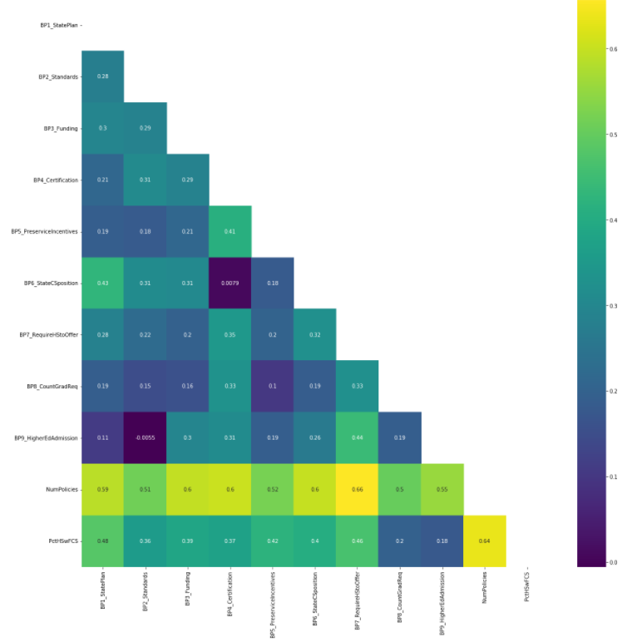
Effect of Individual policies
Correlation matrix between individual policies, number of policies implemented, and % of HS with Foundational CS

Slide 13
Correlation of Individual Policies vs. Success Metrics
 | PctHSwFCS | PctStudentsHSwCS | PctInFCS
BP1_StatePlan | 0.48 | 0.40 | 0.17
BP2_Standards | 0.36 | 0.35 | 0.25
BP3_Funding | 0.39 | 0.37 | 0.19
BP4_Certification | 0.37 | 0.32 | 0.26
BP5_PreserviceIncentives | 0.42 | 0.32 | 0.09
BP6_StateCSposition | 0.40 | 0.37 | 0.24
BP7_RequireHStoOffer | 0.46 | 0.48 | 0.23
BP8_CountGradReq | 0.20 | 0.18 | 0.23
BP9_HigherEdAdmission | 0.18 | 0.14 | 0.25
NumPolicies | 0.64 | 0.57 | 0.36
 | PctHSwFCS | PctStudentsHSwCS | PctInFCS
BP1_StatePlan | 0.76 | 0.70 | 0.48
BP2_Standards | 0.56 | 0.61 | 0.70
BP3_Funding | 0.61 | 0.64 | 0.52
BP4_Certification | 0.59 | 0.56 | 0.72
BP5_PreserviceIncentives | 0.66 | 0.57 | 0.25
BP6_StateCSposition | 0.64 | 0.64 | 0.68
BP7_RequireHStoOffer | 0.73 | 0.84 | 0.66
BP8_CountGradReq | 0.31 | 0.32 | 0.64
BP9_HigherEdAdmission | 0.28 | 0.25 | 0.72
NumPolicies | 1.00 | 1.00 | 1.00
Absolute Correlation Value
Correlation Value Relative to
# of Policies Correlation
Tables Created By Copying Data from Various Jupyter Notebooks and further processing/formatting in Excel

Slide 14
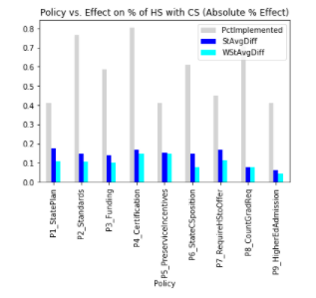
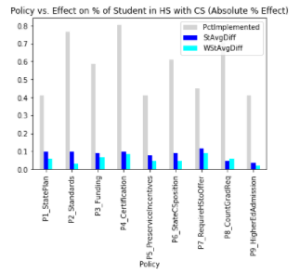
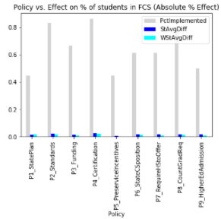
Policy vs % CHANGE (ABSOLUTE)
Grey - % states policy implemented
Blue - % Difference between Avg implemented vs. not (state equal weight
Cyan - % Difference between Avg implemented vs. not (state size weighted)
% HS with Foundational CS
% Students in HS w/ CS
% Students in Foundational CS

Slide 15
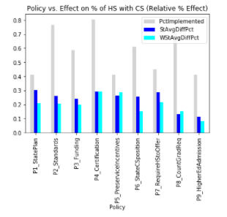
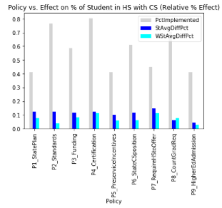
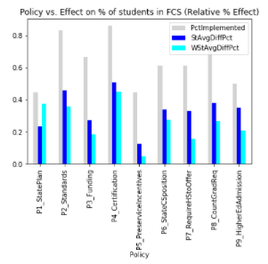
POLICY VS. % CHANGE (RELATIVE)
Grey - % states policy implemented
Blue - % Difference between Avg implemented vs. not (state equal weight
Cyan - % Difference between Avg implemented vs. not (state size weighted)
% HS with Foundational CS
% Students in HS w/ CS
% Students in Foundational CS

Slide 16
observations
Correlation between number of policies and other success metrics provides a baseline to understand the relative strength of each policy.
Number of policies is more strongly correlated to all success metrics than any one policy
Low positive correlation between individual policies seems to be a good sign
P7 Requiring all schools to offer CS has strong correlation across all success metrics
P6 CS Supervisor provides moderate correlation across all success metrics

Slide 17
More Observations
P1 State Plan has strong correlation at Capacity/Access layer, but weak correlation at Participation layer
P2 Standards, P4 Certification, P9 Higher Ed Admission have weak correlation at Capacity/Access layer, but stronger correlation at Participation layer. However, Participation layer only shows weak correlation to current tracked policies
P3 Funding, P5 Preservice Programs, P8 Count Grad Requirements have weak correlation at two of layers and only moderate correlation at one layer

Slide 18
Overall Conclusions and Recommendations
TBD/For Discussion

Slide 19
Links
Google Colab Notebooks
https://colab.research.google.com/drive/1AM9XiDWffbZK6fpejKGW4VNHQjML3p5L?usp=sharing
https://colab.research.google.com/drive/1px_IbXFVVEIbGNbCBs_AbUEefjK1pv57?usp=sharing
https://colab.research.google.com/drive/1XTa2745XZNSxDYkrQNwDq_5xQB-wtYJC?usp=sharing
Data Files
https://drive.google.com/file/d/1jCUBaWoe52GdzIwLaM7TcZ_SQll9JgIv/view?usp=sharing (CSV)
https://docs.google.com/spreadsheets/d/1MZpi5Nid-BfpQ833Uy9rYgrvD8H3Yads/edit?usp=sharing&ouid=112866292549895118363&rtpof=true&sd=true (XLSX used to create CSV)
Original Data Sources
https://advocacy.code.org/2021_State_of_CS_data.xlsx (Numeric Data)
http://bit.ly/9policies (Policy data)

Slide 20
PLANNED NEXT Steps
Further Jupyter file cleanup and documentation
Public Github Checkin. Kaggle?
Gender/Ethnicity Data Study
Location/FRL Data Study?
Analysis with other state population/education data?

